Slide 1
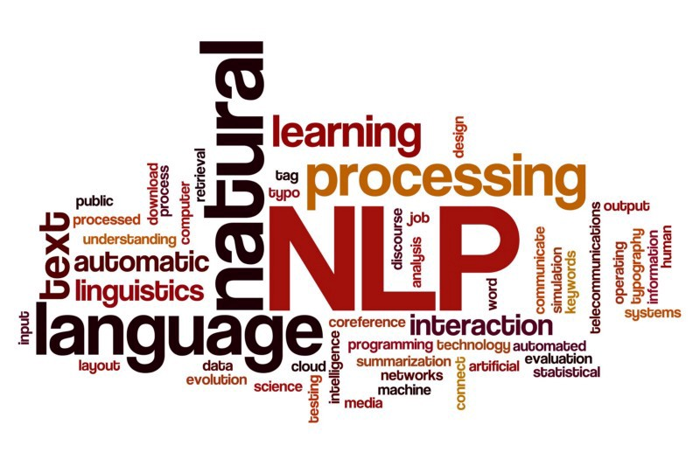
Natural Language Processing
P.L.N. Sai Teja
17241A04M4
ECE-D

Slide 2
TABLE OF CONTENTS
01
02
03
04
05
06
Intro to NLP
Text Processing
Feature Extraction
Neural Networks
Recurrent Neural Networks and Attention Model
Applications

Slide 3
01
Introduction to NLP

Slide 4
DEFINITION
Natural language processing (NLP) is a branch of artificial intelligence that helps computers understand, interpret and manipulate human language.

Slide 5
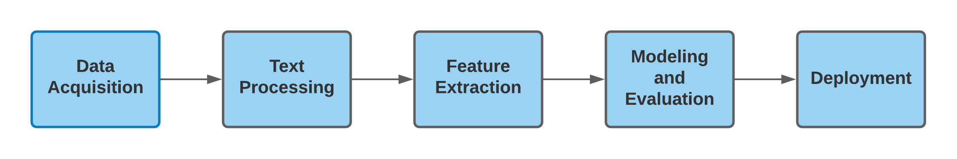
BASIC NLP PIPELINE

Slide 6
02
Data Acqusition and Text Processing

Slide 7
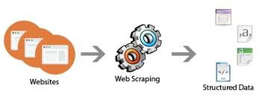
How do we get Text?
Webscraping by using beautiful soup python library
PDF
Books
Emails
SMS

Slide 8
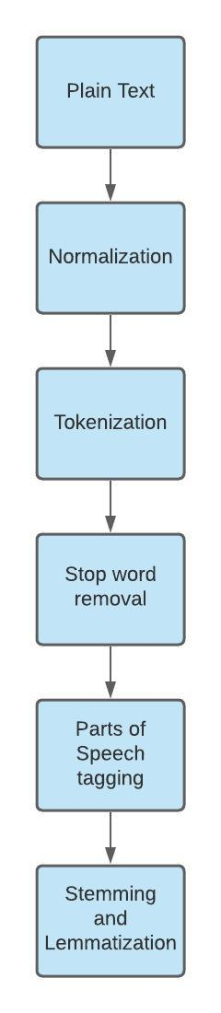

Slide 9
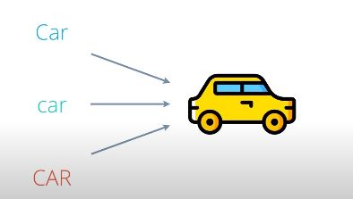
Case Normalization
Tokenization is a way of separating a piece of text into smaller units called tokens. Here, tokens can be either words, characters, or subwords.
A stop word is a commonly used word (such as “the”, “a”, “an”, “in”) that a search engine has been programmed to ignore, both when indexing entries for searching and when retrieving them as the result of a search query.
We would not want these words to take up space in our database, or taking up valuable processing time. For this, we can remove them easily, by storing a list of words that you consider to stop words. NLTK(Natural Language Toolkit) in python has a list of stopwords stored in 16 different language

Slide 10
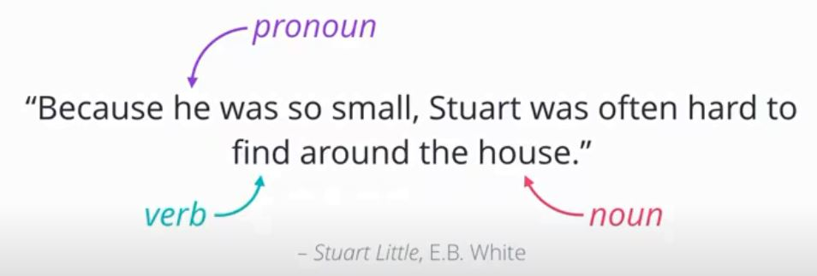
Parts of Speech Tagging
Lookup tables
Hidden Markov Models

Slide 11
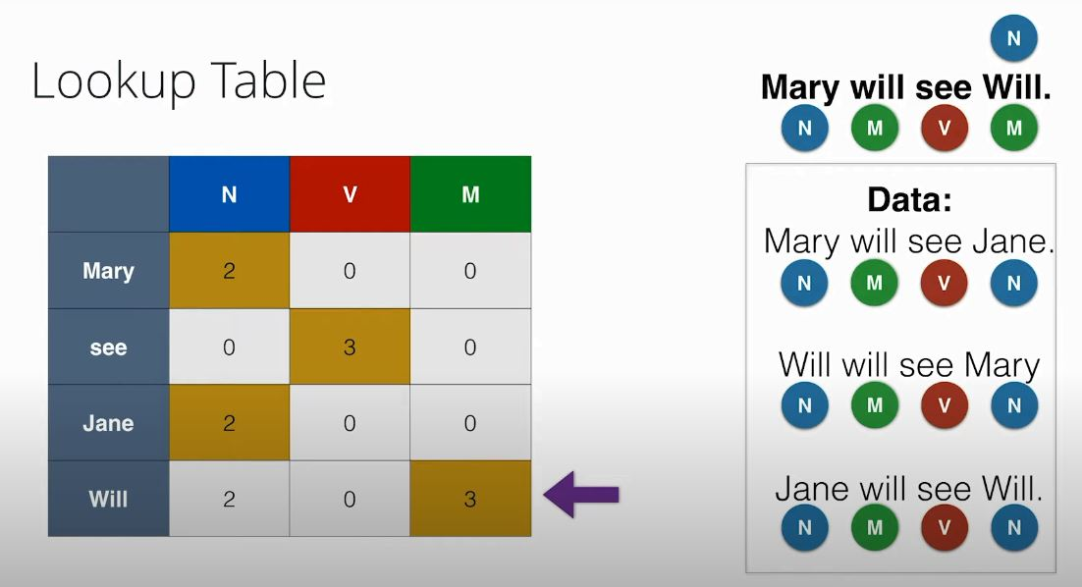
Why Lookup tables won’t work in PoS tagging?

Slide 12
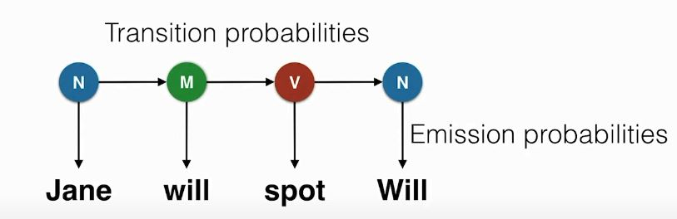
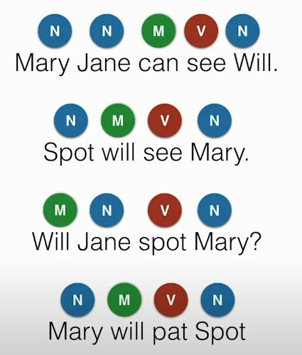
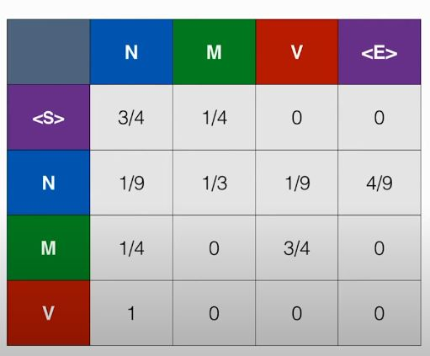
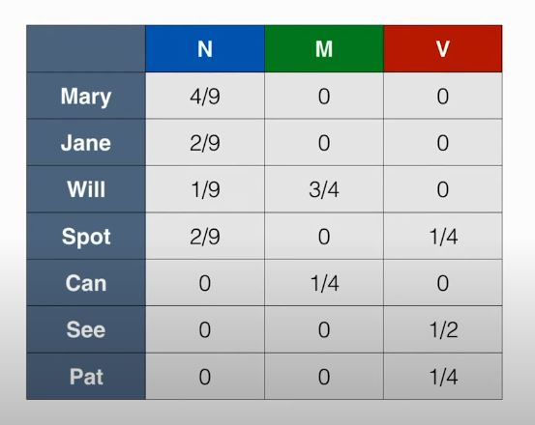
Hidden Markov Model Alogorithm
Transition Probabilities
Emission Probabilities

Slide 13
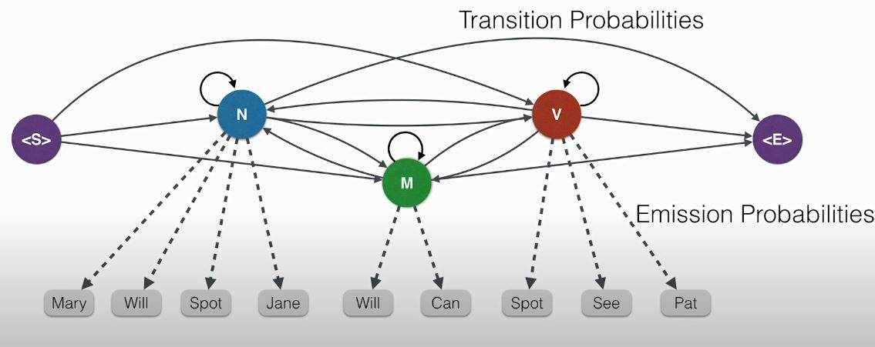
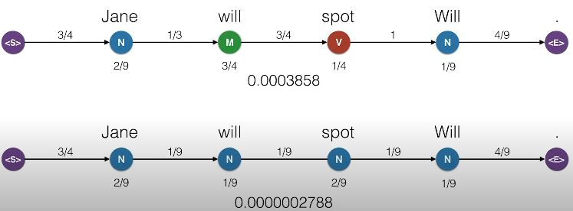
Final HMM

Slide 14
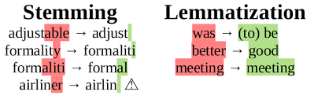
Stemming and Lemmatization
Stemming is basically removing the suffix from a word and reduce it to its root word.
Lemmatization is similar to stemming but it brings context to the words. So it links words with similar meaning to one word.

Slide 15
03
Feature Extraction

Slide 16
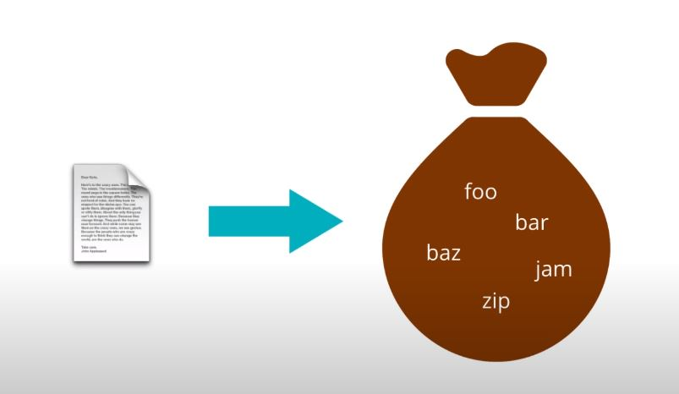
Bag of words Model
After Text Processing we get a bunch of words in each document . We consider these as a bag of words.
So document has a bag of words. Now we will take only unique words and represent them as colums and each document as a row to form Document-Term matrix
The main drawback size of document increases this model will not work.

Slide 17
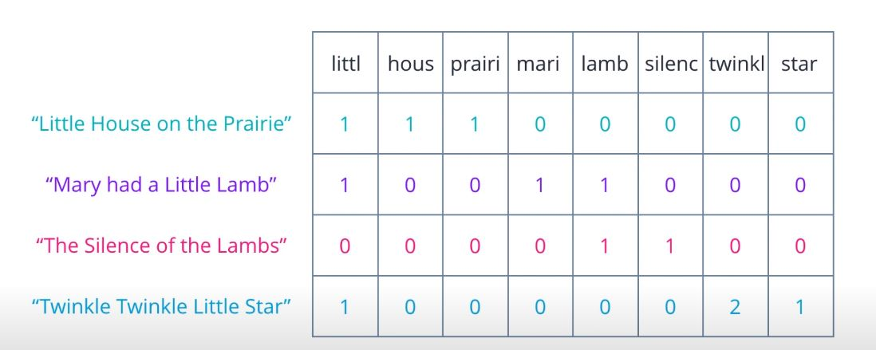

Slide 18
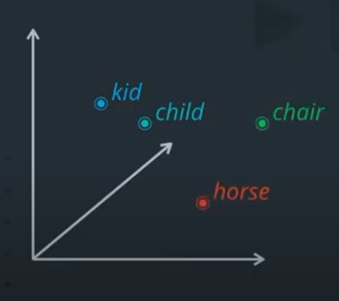
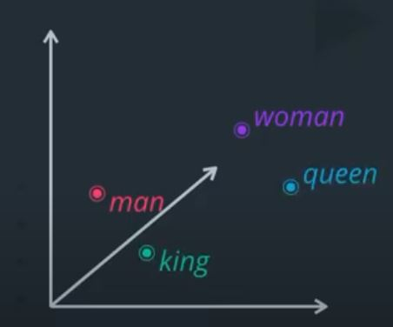
Word Embeddings
It’s main aim is to represent words in vector form without losing contextual information.
It allows words with similar meaning to have a similar representation. They can also approximate meaning.
To use a word to predict the words around it
Inter word semantics must be captured

Slide 19
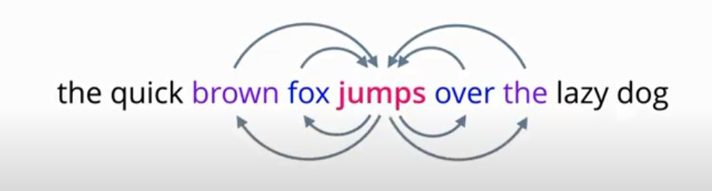
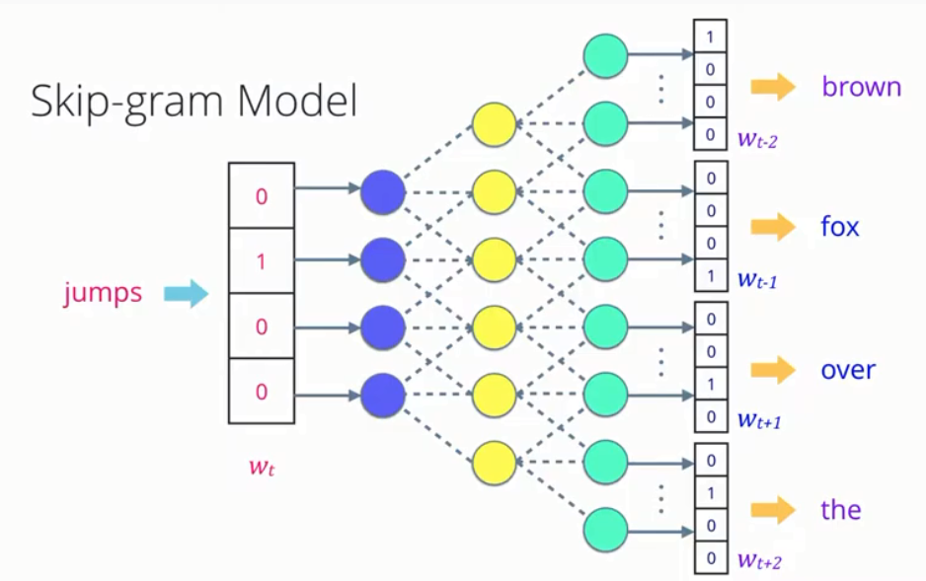
Word2VEC – SkipGram Model

Slide 20
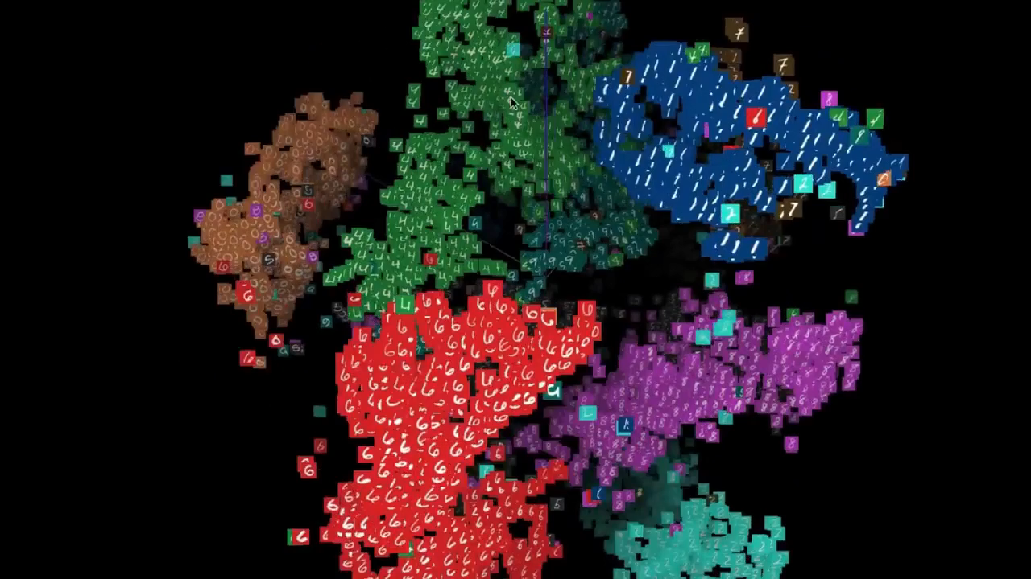
T-SNE VISUALIZATION

Slide 21
04
Neural Networks

Slide 22
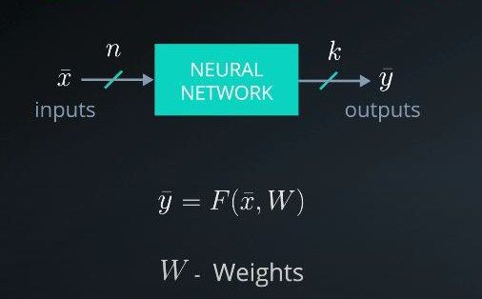
What are Neural Networks?
Neural networks are comprised of a node layers, containing an input layer, one or more hidden layers, and an output layer. Each node, or artificial neuron, connects to another and has an associated weight and threshold. If the output of any individual node is above the specified threshold value, that node is activated, sending data to the next layer of the network. Otherwise, no data is passed along to the next layer of the network.

Slide 23
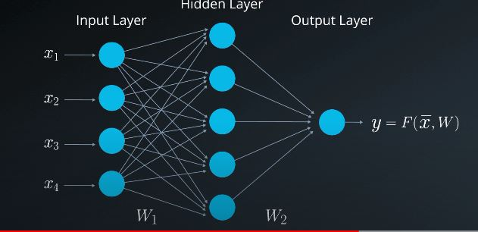
Task of Neural Networls
The goal of Neural Networks is to find the accurate set of weights which accurately predict the output.

Slide 24
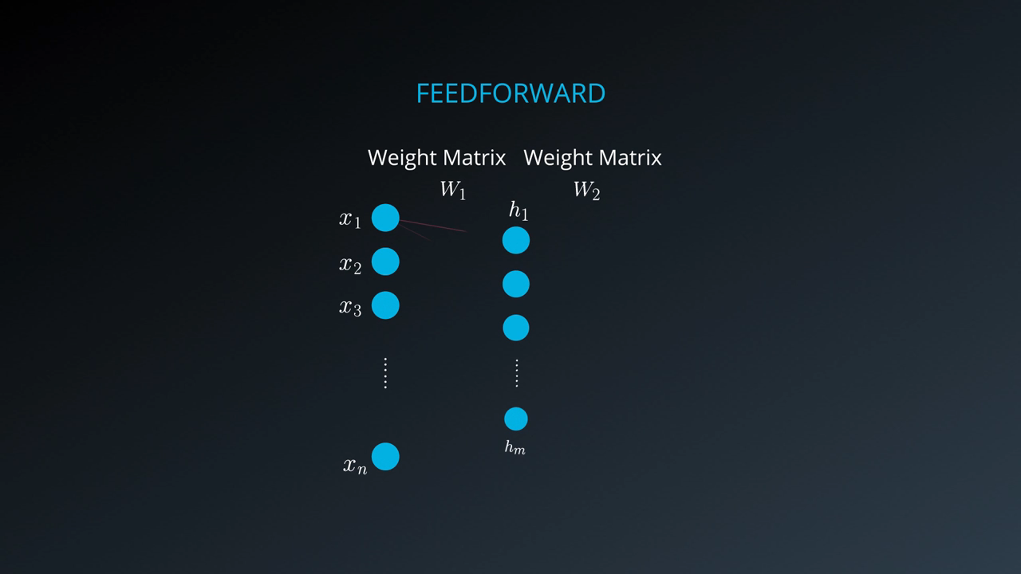
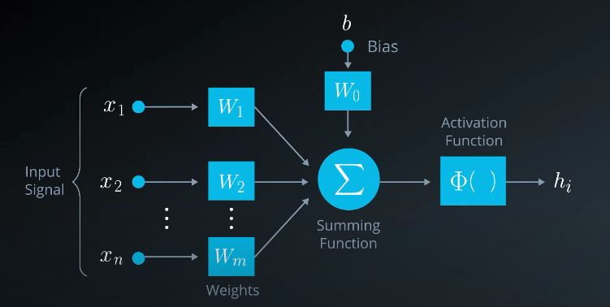
Feed Forwading in Neural Networks

Slide 25
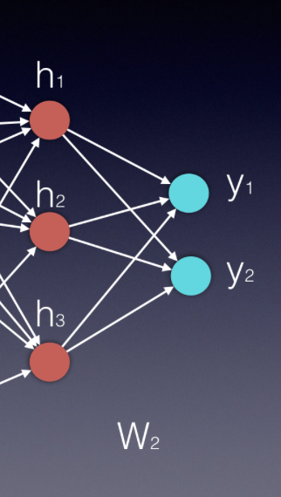
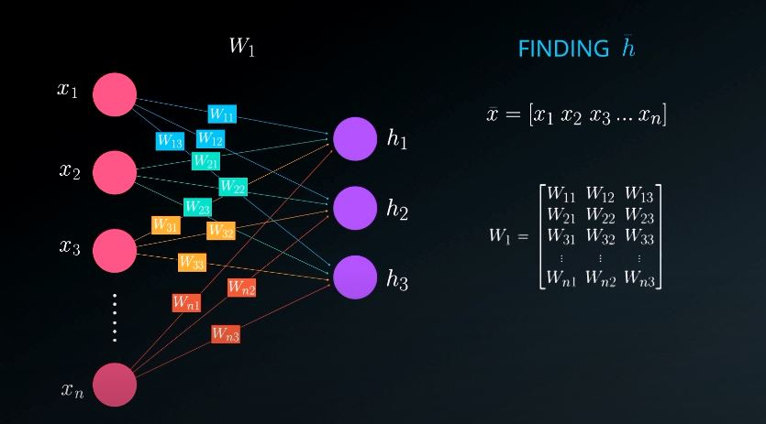
Training in Neural Networks

Slide 26
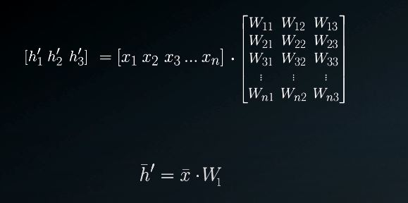
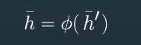
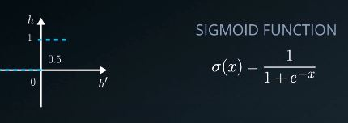

Slide 27
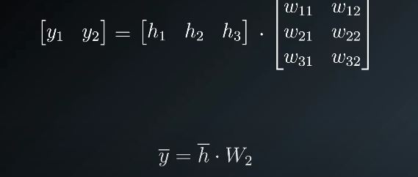
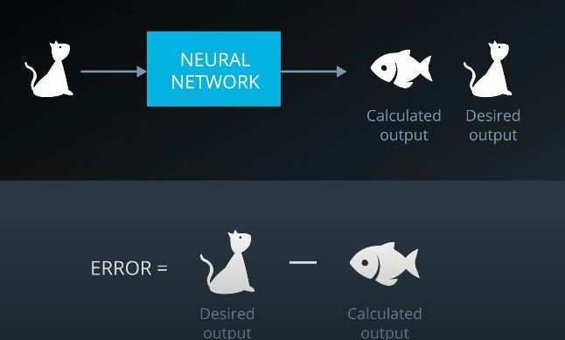
Error determination
Mean Square Error

Slide 28
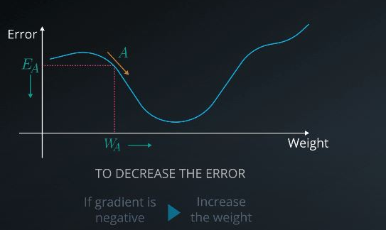
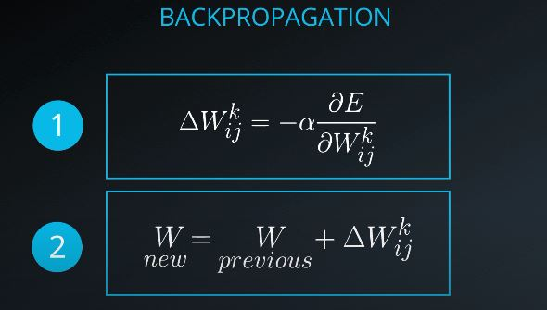
Gradient Descent and Back progagation

Slide 29
05
Recurrent Neural Networks

Slide 30
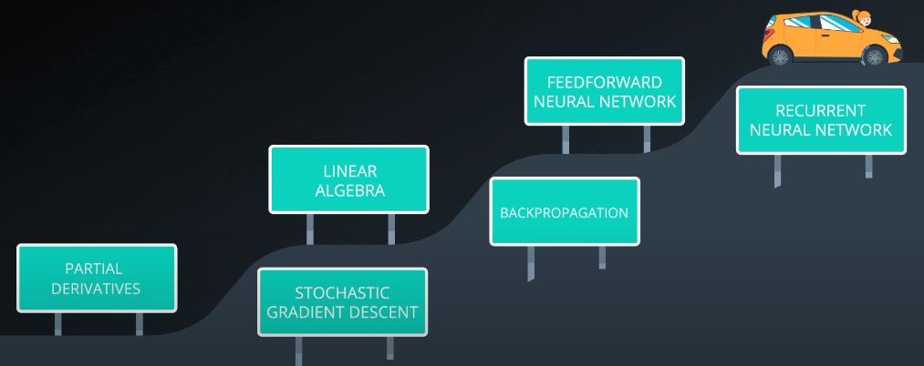
ROAD MAP FOR RNN

Slide 31
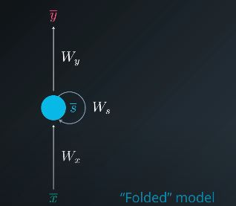
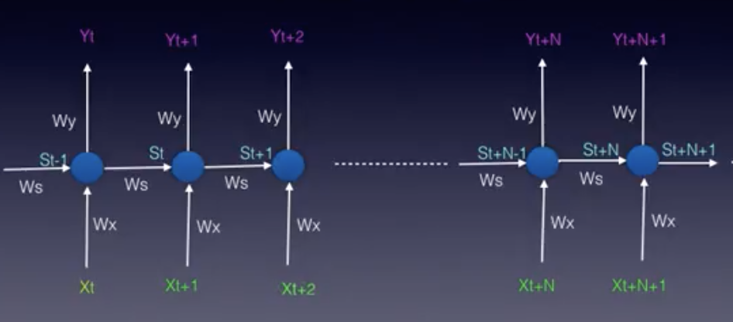
Difference between NN vs RNN
There are two main differences between FFNNs and RNNs. The Recurrent Neural Network uses:
sequences as inputs in the training phase, and
memory elements
RNNs can take care of temporal dependencies i.e dependencies over time.

Slide 32
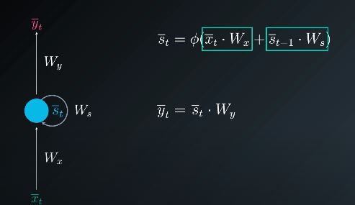
Feed Forwading in RNN

Slide 33
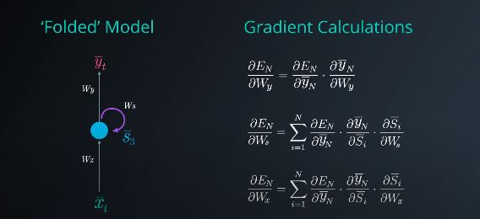
Back Progagation in RNN
Here we come across Accumulated Gradients as past inputs also come into picture

Slide 34
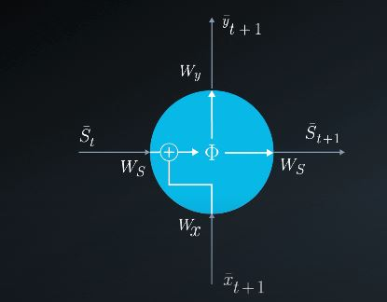
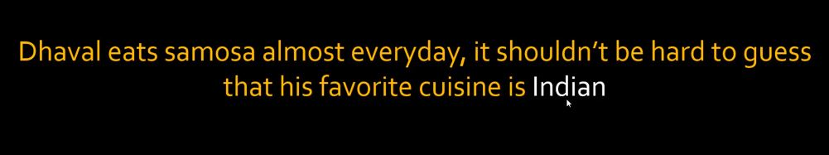
Vanishing Gradient

Slide 35
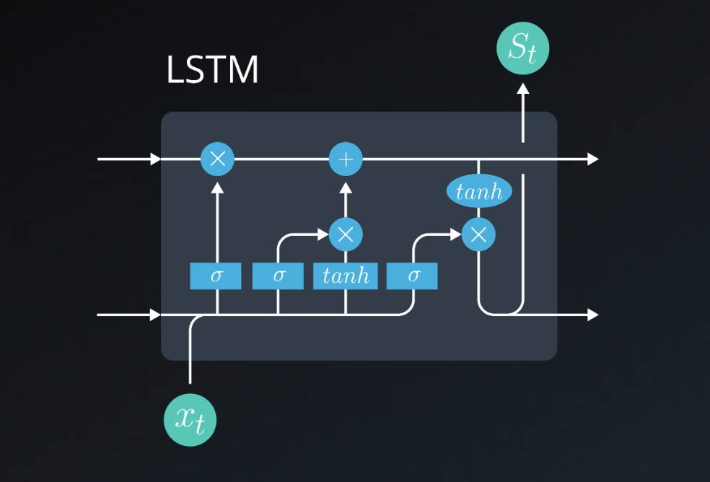
LSTM

Slide 36
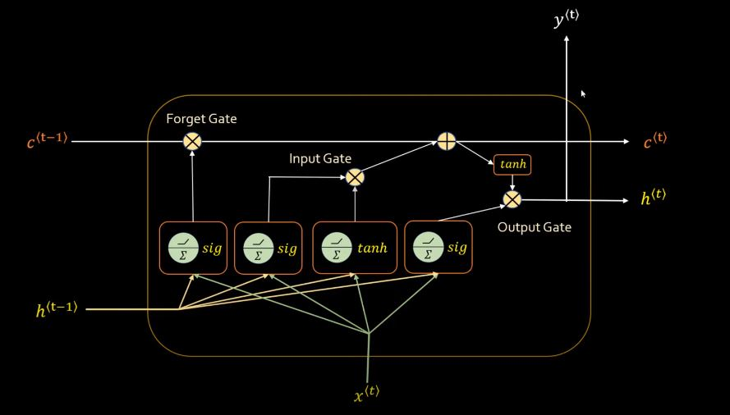

Slide 37
06
Attention Model

Slide 38
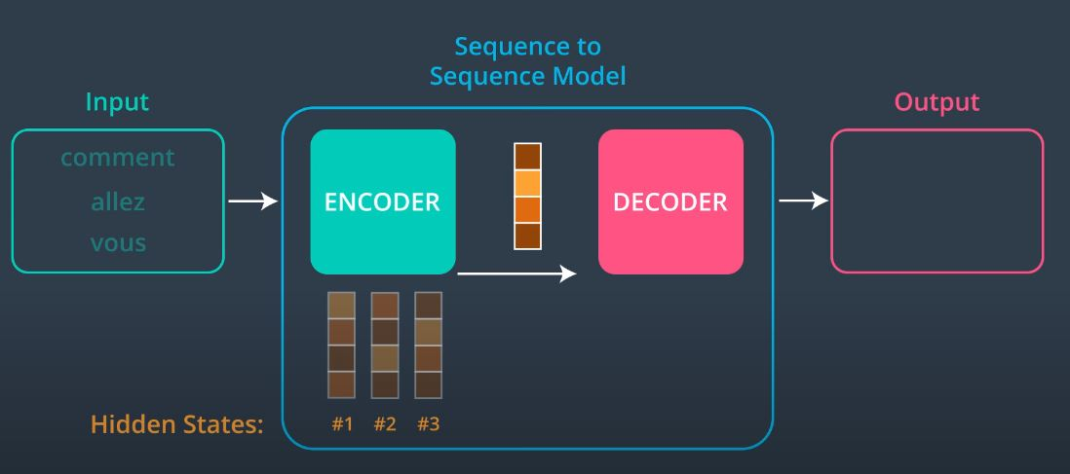
Sequence to Sequence Models
context
How
Are
You

Slide 39
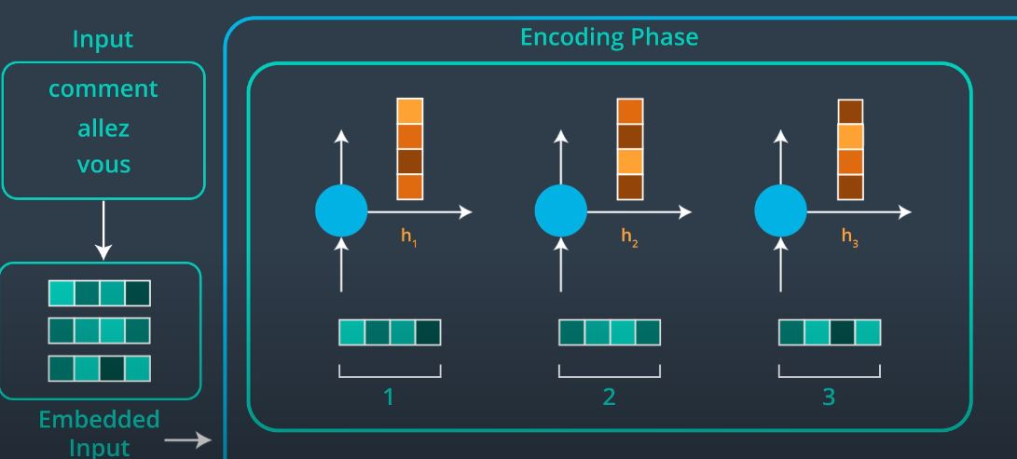
Attention Encoding

Slide 40
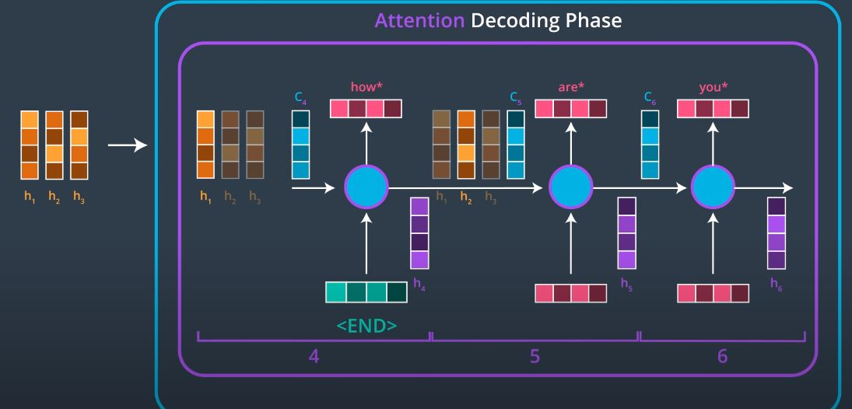
Attention Decoding

Slide 41
Furthur Reading
Multplicative Attention Model
Additive Attention Model
Self Attention

Slide 42
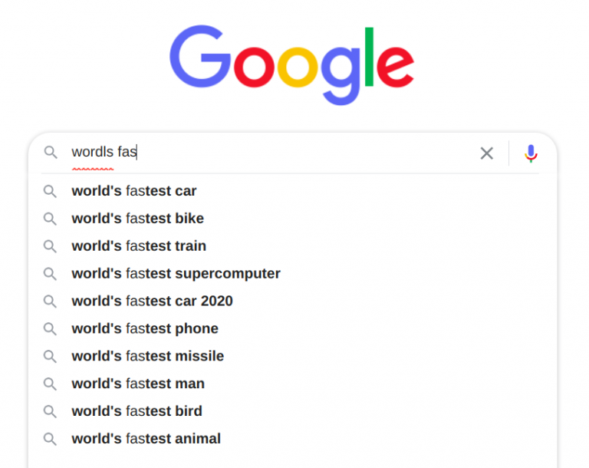
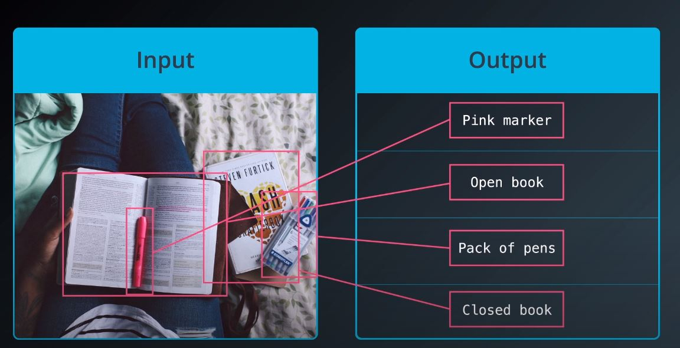
Applications
Language Translator
Targeted Advertising
Image captioning

Slide 43
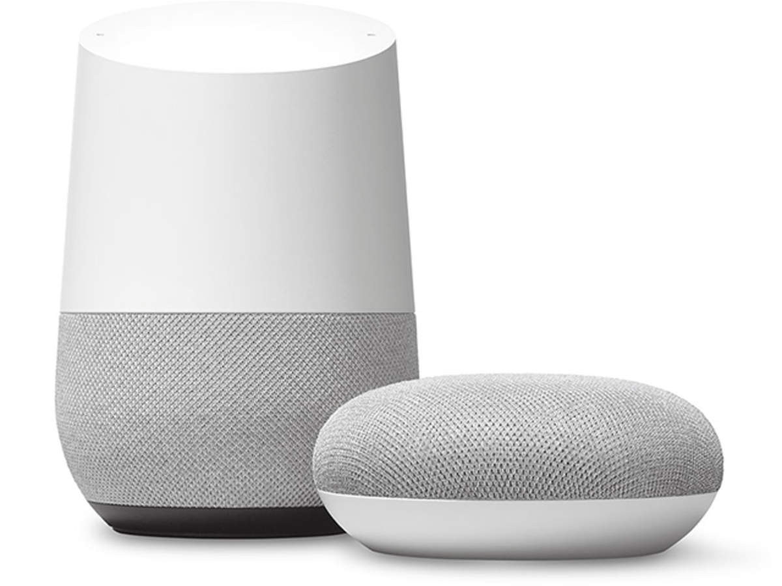
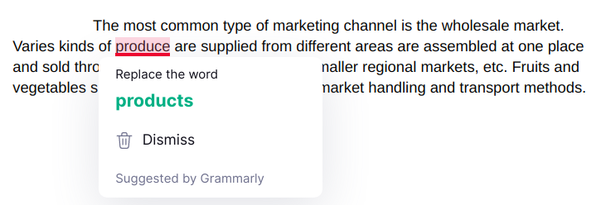
Voice Assistants
Search Autocorrect and Autocomplete
Grammar Checkers

Slide 44


Chatbots
Survey Analysis
Email Filtering

Slide 45


THANK YOU

